Slide 1
The One-Eyed Man Is King:Trump’s Islamic World Policies
Madison Forum
April 27, 2019
Timothy R. Furnish, PhD

Slide 2

Areas to Cover
Immigration
Major Allies in ME
ISIS Policy
Counter-terrorism Strategy

Slide 3
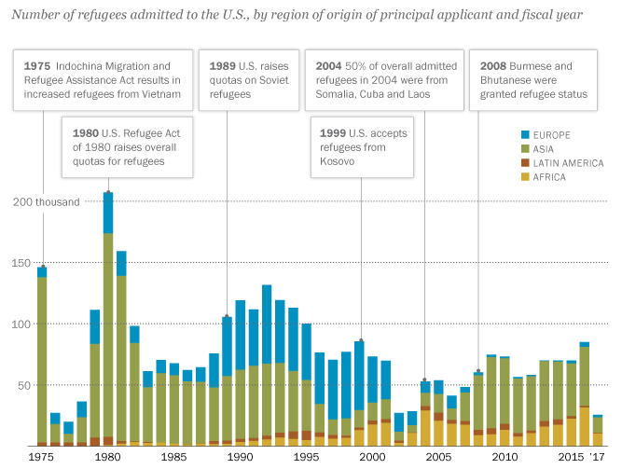
Refugees (not immigrants!) by year, 1975-2016. Immigrants/year averaged over 1 million for most of the 21st c.

Slide 4
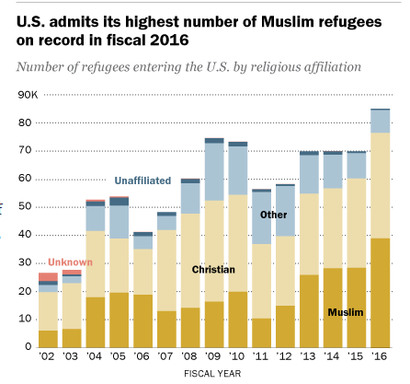
Muslims > Christians
2002-2016: 400k Christian refuges v. 280k Muslim
BUT....numbers of latter increased greatly in BHO’s 2nd term
And....why?! Christianity is the most-persecuted religion on the planet, AND the US is still majority (70%) Christian
2016: record # of Muslims: 39k
What is data for ‘17, ’18, last years of BHO Administration?
Election of Ilhan Omar (D-MN 5th district) direct result of this

Slide 5
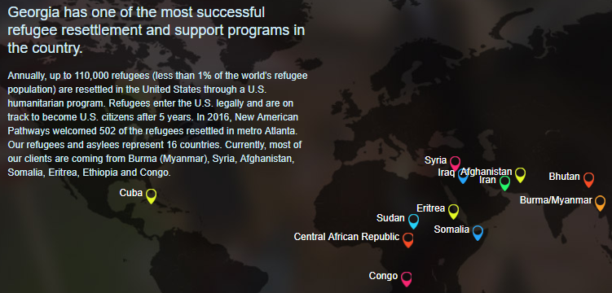
From “New American Pathways” (Episcopal)

Slide 6

From the “AJC,” Jan. 29, 2017
About two-fifths of the refugees -- more than 400 people -- were from the seven mostly Muslim nations specifically targeted by the executive order signed by President Trump Friday [sic]. However, the immigration order halts all refugees, regardless of their nationality, from resettling in the U.S. for four months, and halts the arrival of all refugees coming in from war-torn Syria indefinitely.
Georgia took in 164 Syrians, 133 Somalians, 78 Iranians and 42 Iraqis.
(Data is for 4th quarter of 2016.)

Slide 7
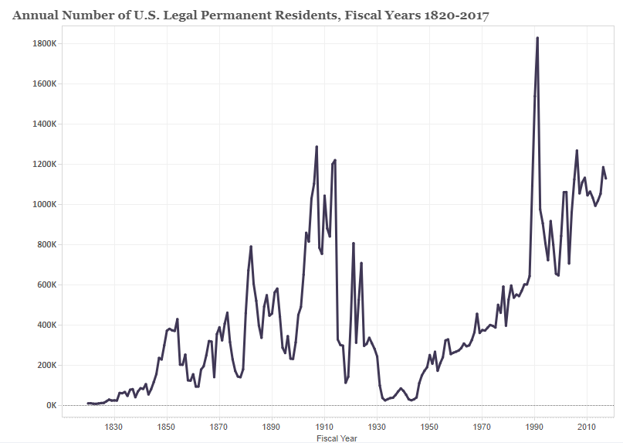
Thanks, Bush I & Teddy. 45 million legal immigrants (13.7%, still under historic high of 14.8% in 1890).

Slide 8
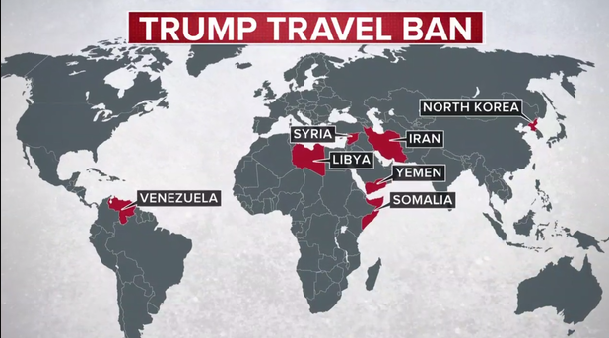
Trump “Muslim” Travel Ban
Iran, Libya, Syria, Yemen, Somalia, North Korea, Venezuela
88% of world’s Muslims unaffected
Libya, Syria, Yemen & Somalia are failed states with few to no export controls
NoKo is, well, NoKo
Venezuela is a failing socialist state
Iran is world’s top terrorism sponsor
Upheld by SCOTUS summer 2018

Slide 9
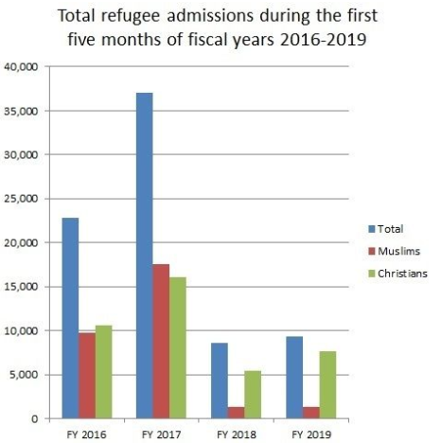
But under Trump....
Refugees accepted: from 85k/year under Obama to 45k, then to 30k this year
Christian refugees now outnumbering Muslim ones: through March 2019, 83% Christian, 14% Muslim
Most from DRC, Ukraine, Burma, Eritrea
Criticism: very few Christians admitted from Syria (but BHO had been admitting almost exclusively Muslims from there)

Slide 10
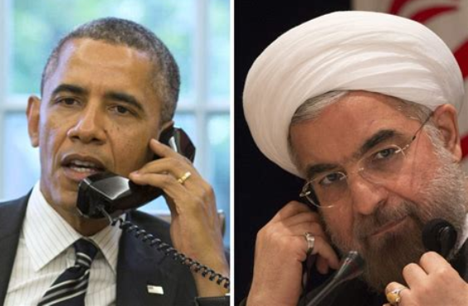
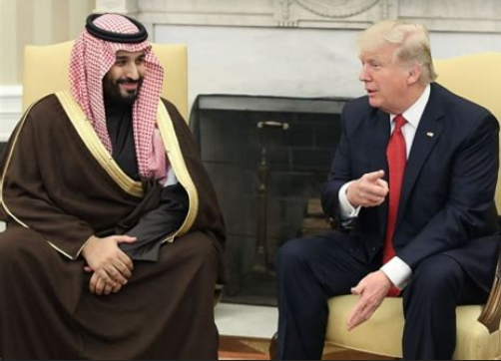
Obama: moved away from Israel, KSA toward Iran (“Iran Deal,” release of frozen funds); problem: no stick, only carrots, for world’s foremost state sponsor of terrorism
Trump: called Iranian terrorist spade a spade, renewed US traditional alliance (from FDR) with KSA; problem: KSA is politically Western ally BUT its Wahhabi Islam is virtually same as that of ISIS, AQ, etc.

Slide 11
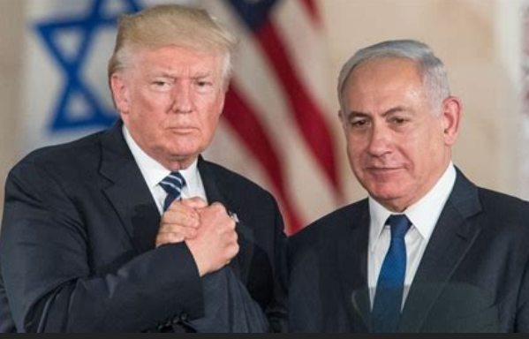
Trump & Israel
Trump ditched Obama’s acrimomy toward Israel
Moved US embassy to Jerusalem & recognized Israel’s annexation of Golan Heights
(KSA & Israel de facto allies, now)

Slide 12
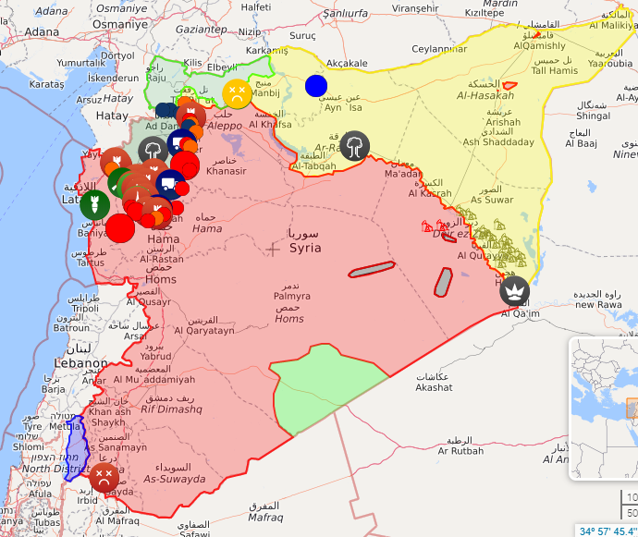
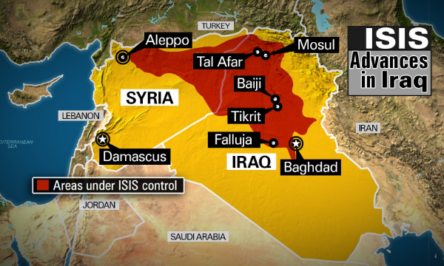
ISIS’ Caliphate destroyed by Trump unleasing US Special Forces & Arming the Kurds—unlike Obama’s “decimation” strategy
But.....

Slide 13
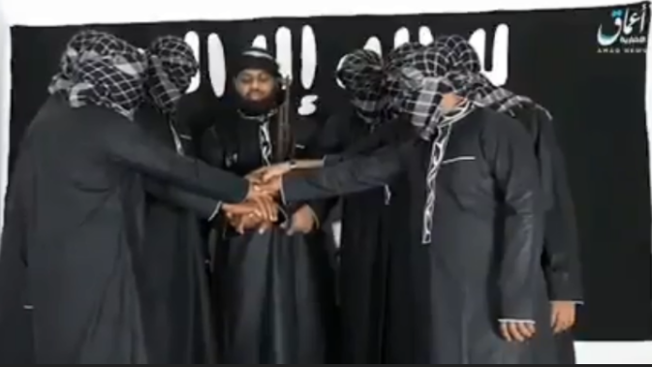
Thawheed Jama`ath (Sri Lanka jihadists who killed all those “Easter Worshippers”) leader pledging allegiance to ISIS.

Slide 14
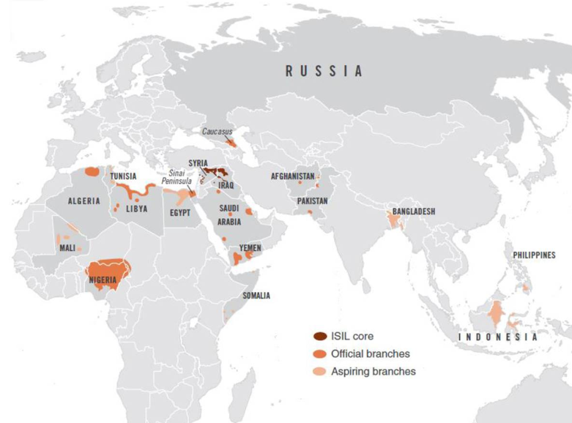
ISIS has returned to its terrorist roots

Slide 15
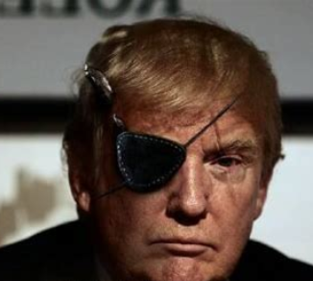
Trump CT Strategy
Bush & Obama both: thought “Arab Spring” & Pakistan would help CT; also only mentioned Islam once (to say AQ “distorted interpretation” thereof)
Trump’s 2018 National CT Strategy: calls out “radical Islamist terrorism” 16 x; says we must do more than kill terrorists—we must go after networks & supports.
BUT “radical Islamist terrorism” is incorrect. And it mentions “twisted ideologies that...justify the murder of innocent victims.”
Lists Nordic Resistance Movement & some other very marginal ones as threats equal to jihadists
Keeps Gitmo open!
But one-eyed is better than blind!

Slide 16
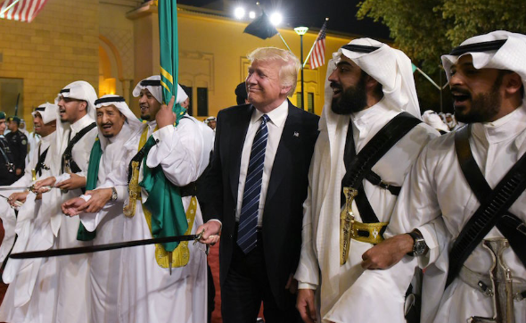
Speak loudly—and carry a large sword!

